Slide 1
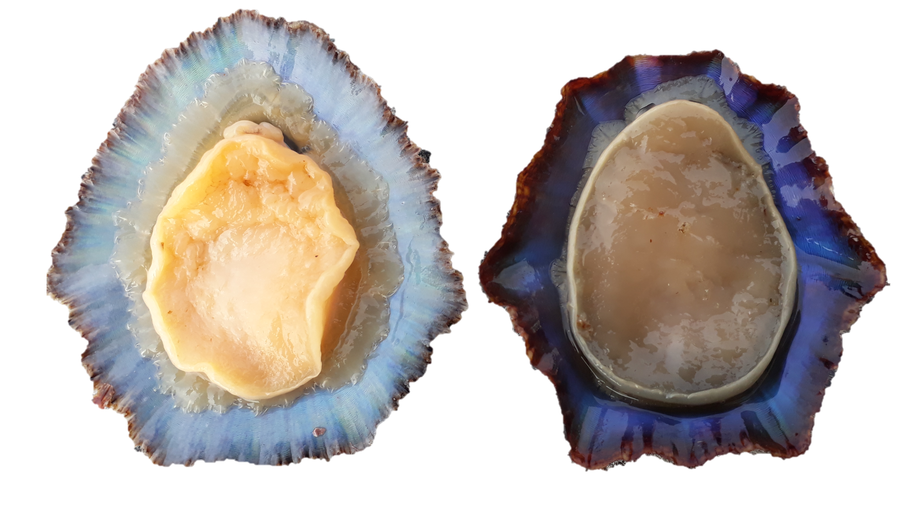
Trochophore
Early Verliger
(before torsion)
Late Verliger
(posttorsional larval stage)
EGG
8-9
hours post fertilization (hpf)
36-41 hpf
Abbreviations:
act, apical ciliary tuft;
alr, accessory larval retractor;
ft, anlage of foot;
Hpf, hours post fertilization
lmf, longitudinal mantle fibres,
lsm, left shell muscle,
mf, mantle fold;
mlr, main larval retractor;
op, operculum;
pt, prototroch.
pp, pedal plexus,
rsm, right shell muscle,
te, cephalic tentacle,
tmf, transversal mantle fibres,
vh, visceral hump,
vr, velum (muscle)
51 hpf
54 hpf
147 hpf
170 hpf
Adult
Size at first maturity = 37.5mm
Age at first maturity = 2 years
Juvenil
Metamorphosis
Defined by the:
reduction (loss) of the velum.
presence of food in the gut.
Patella aspera
Patella candei
1–5 days after
metamorphosis

